Slide 1
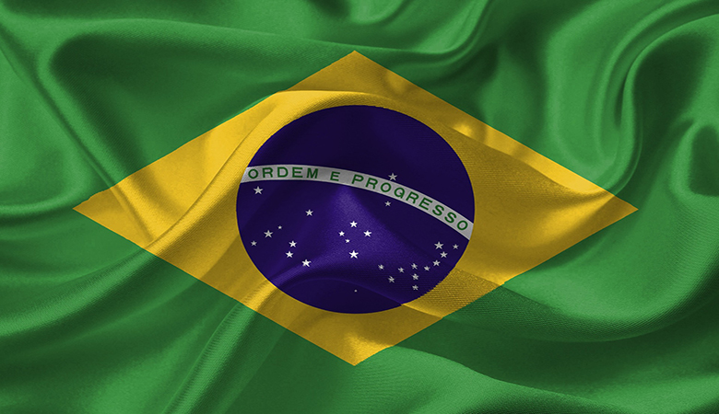
Brazil
Keito Ida
Nanase Hashimoto

Slide 2
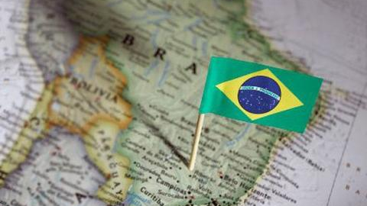
Geography
Notes:
Next, I talk about geography.

Slide 3
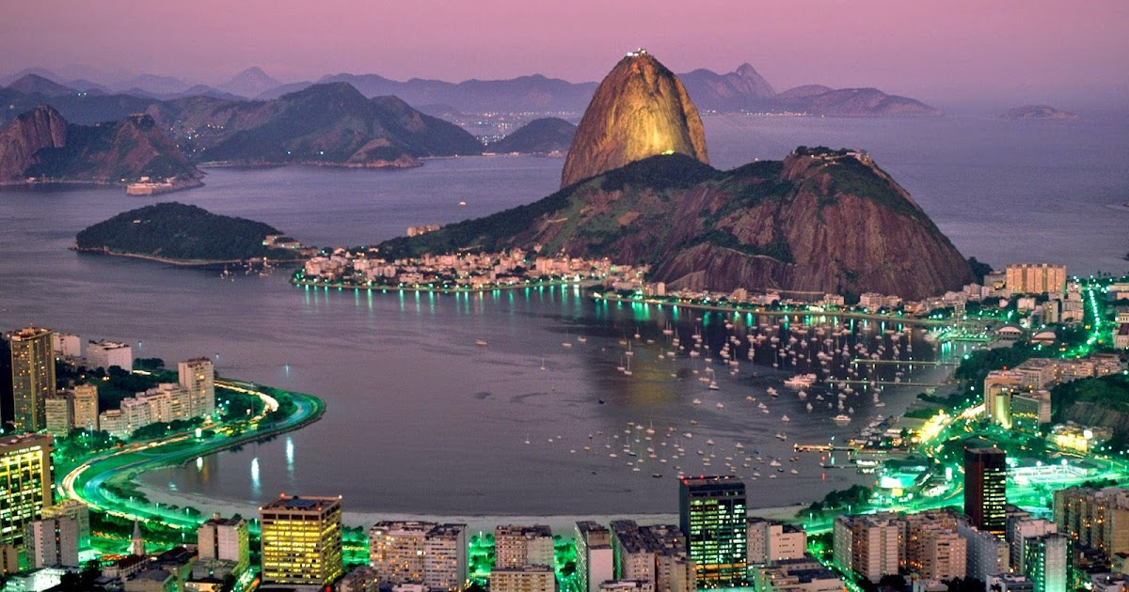
Area
8,515,717㎢
The 5th largest in the world
22.5 times larger than Japan
Notes:
The area of Brazil is about 8.5 million square kilometers.
It is the 5th largest in the world.
This is 22.5 times larger than Japan.

Slide 4
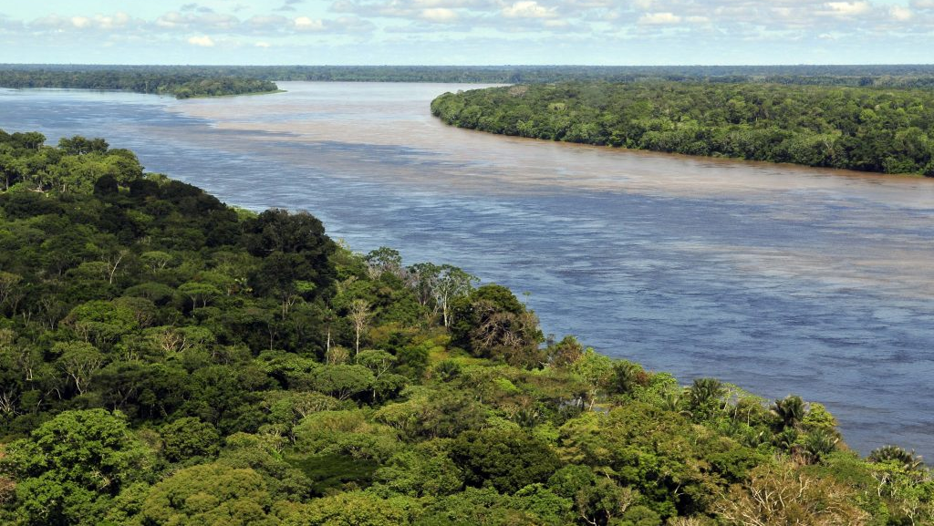
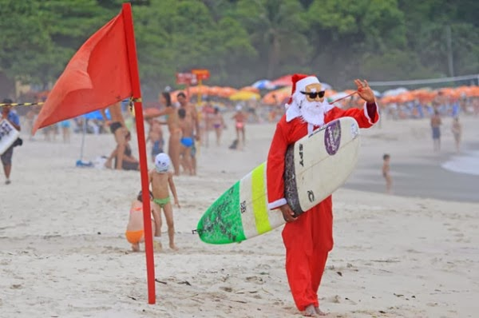
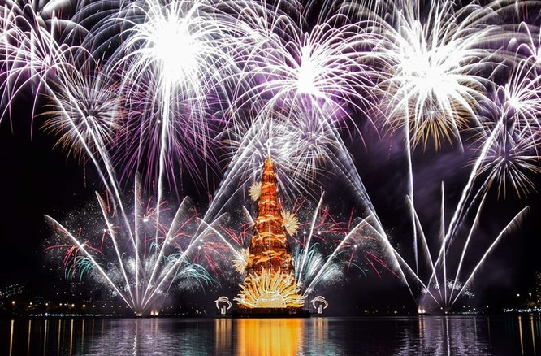
Climate
Recognized by Guinness
Wetlands (swamp)
It is different by areas
North → Sultry(muggy)
South → Cold
The seasons are opposite from Japan
Notes:
Brazil's climate is wetlands.
But it is different by area.
The North of Brazil is Sultry, and the South of Brazil is cold.
The seasons are Japan and the opposite.
So if you go to Brazil in December, you can enjoy a different Christmas than in Japan.
Because Christmas in Brazil is in the summer.
Also, you can see the biggest Christmas tree at Rodrigo (ロドリゴ) lake.
It is recognized by Guinness world records.

Slide 5
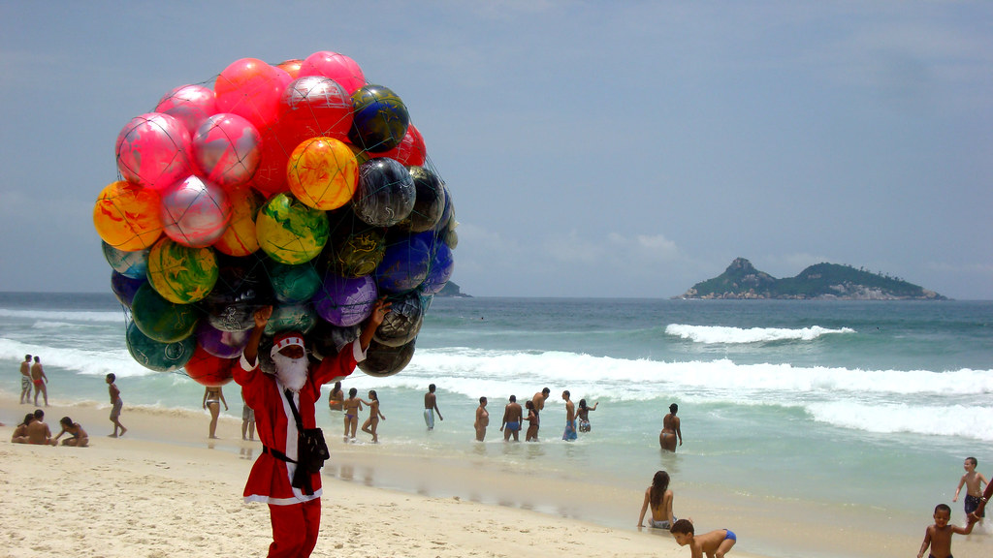
Chrismas in Brazil
Not work
→Cesta de natal and a bonus
Panettone
Amigo secreto
Notes:
Brazilian Christmas is a holiday, so people do not
Cesta de natal(basket)

Slide 6
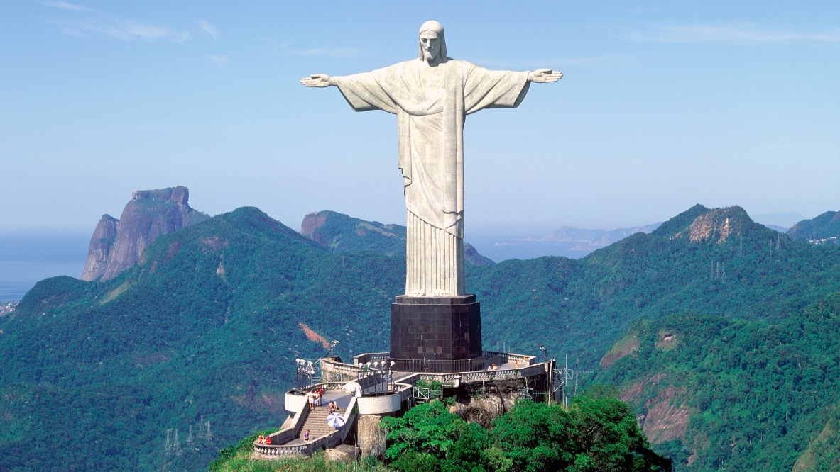
Religion
Roman Catholic
65% of the population affiliated with the religion
The colossal statue of Christ the Redeemer
Notes:
Next, I talk about religion.
Many Catholics are believed in Brazil.
It is 65% of the population affiliated with the religion.
So there is the colossal stature of Christ the redeemer in Rio De Janeiro.
It is a symbol of Brazil.

Slide 7
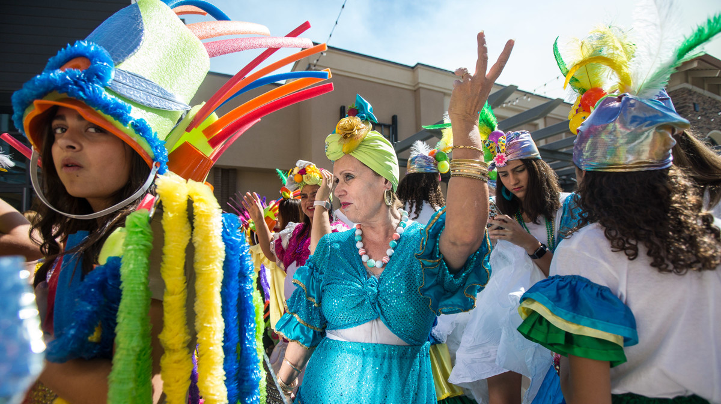
Population
(According to 2021 research)
213,993,441
The largest in the world
５main races
6th
(Brancos, Pardos, Pretos, Amarelos, and indigenas)
Notes:
The population of Brazil is about 200 million.
It is the 6th largest in the world.
Brazil has five main races.
These are Brancos, Pardos, Pretos, Amarelos, and indigenas.

Slide 8
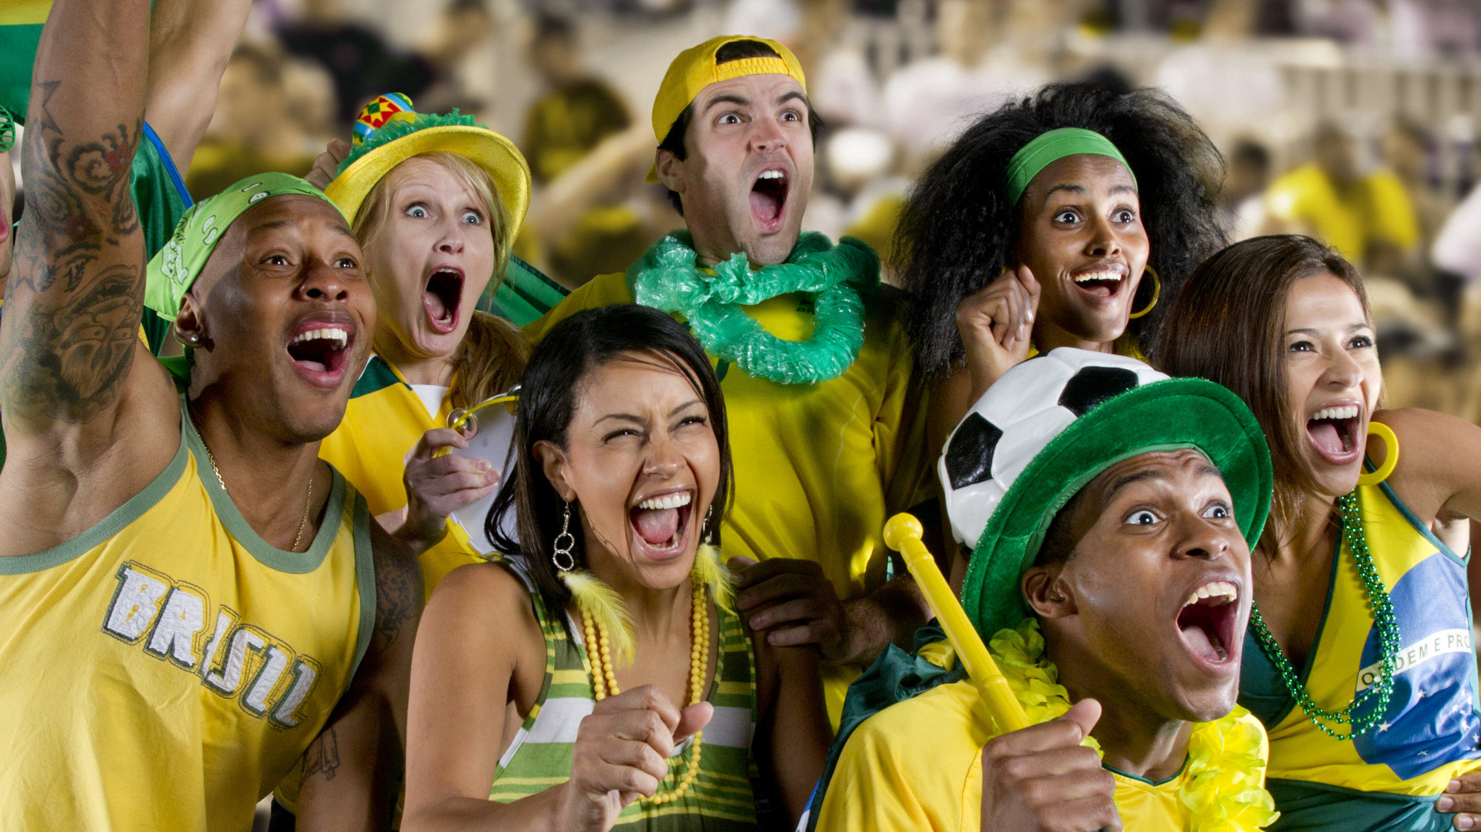
Personality
Friendly and open
Are interested in others
Notes:
Brazilians are friendly and open. Also, they are interested in others, so they like to talk with people and listen to other’s stories. They tend to like to enjoy something with other people.

Slide 9
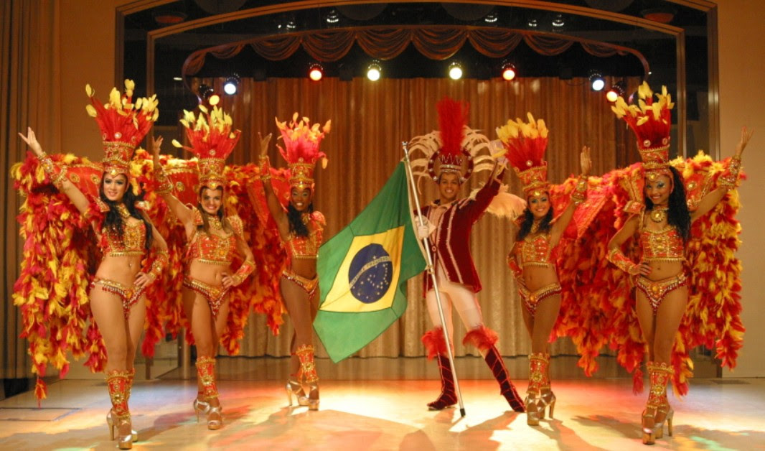
Samba
Notes:
They are proud of their traditional of music and dance. The carnival is traditional events, and Samba is the most popular in Brazil. Brazilians often participate in such an event and enjoy it with others.

Slide 10
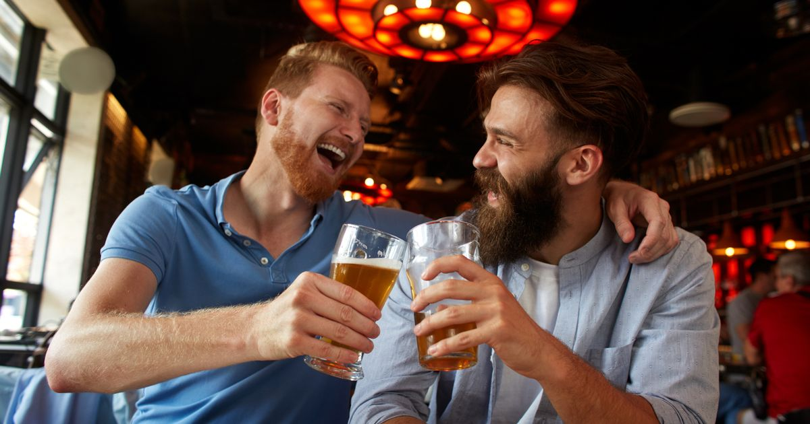
Communication style
Communicate directly
Use body touches
Notes:
Next, I’ll talk about communication style of Brazilian. They tend to communicate directly to people. In addition, they use body touches a lot. Basically, People are close in Brazil.

Slide 11


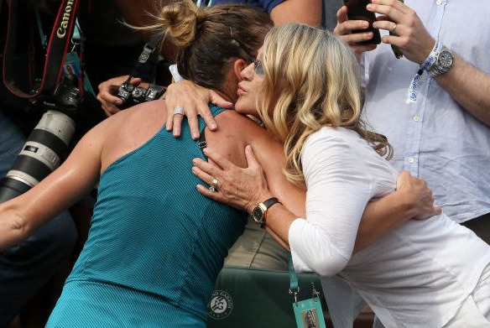
Greeting
Kiss on the cheeks
Shake hands
Hugging and Backslapping

Slide 12
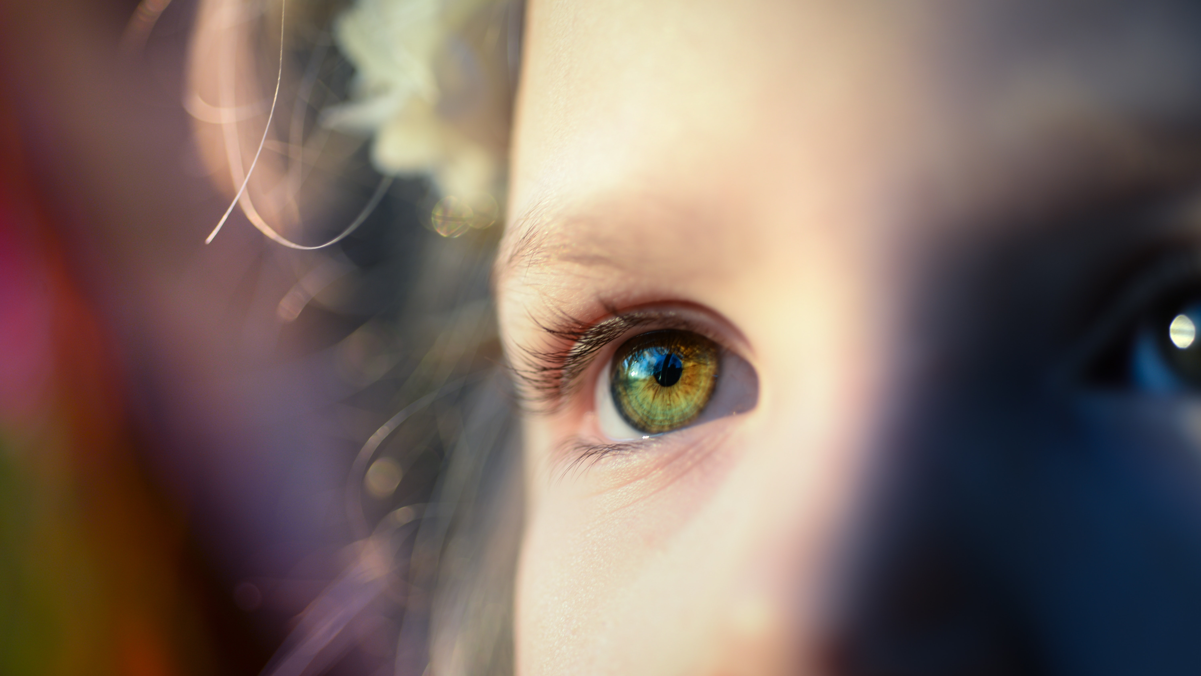
Eye contact

Slide 13
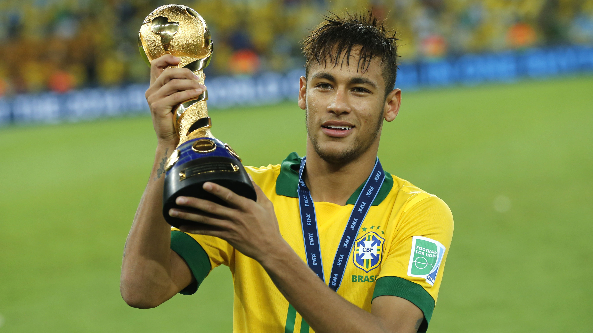
Custom

Slide 14
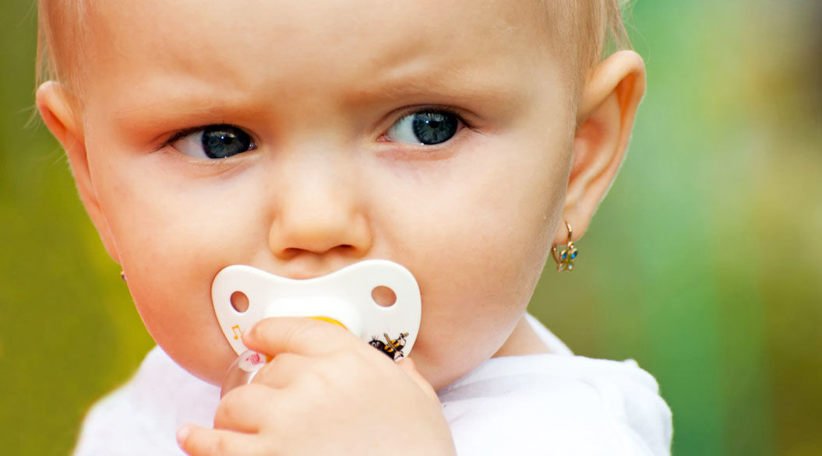
Piercing since childhood
A sign of a girl

Slide 15
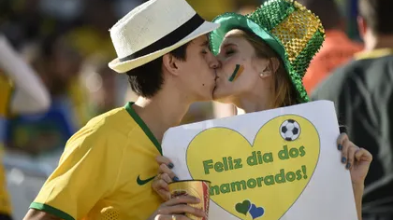
Dia dos Namorados (Lover’s Day)
Jun 12th

Slide 16
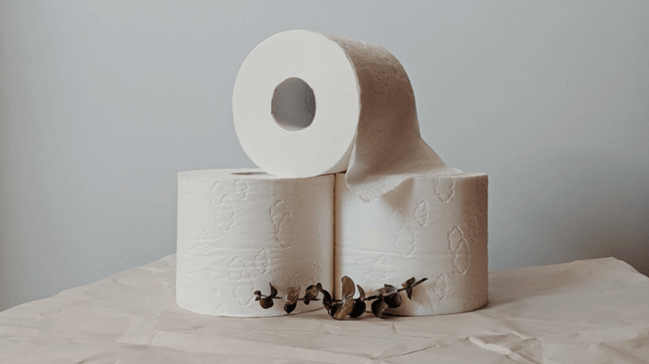
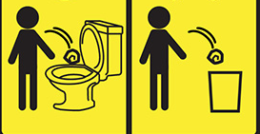
Don’t flush toilet paper

Slide 17
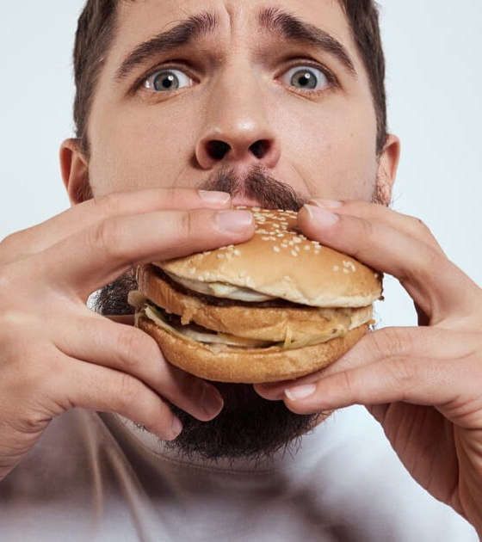
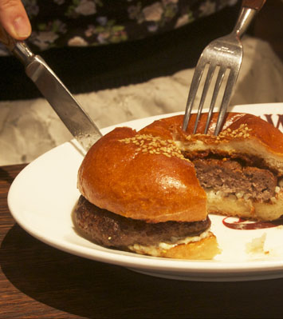
Don’t touch food directly

Slide 18
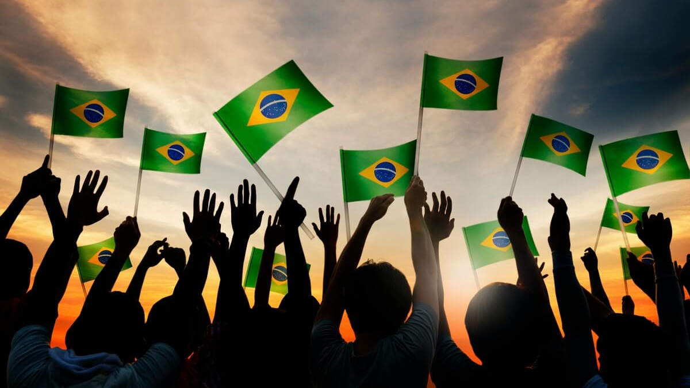
Society
この写真 (作成者: 不明な作成者) は CC BY-SA に基づいてライセンスが許諾されています。
Notes:
Next, I talk about Brazilian society like government and politics.

Slide 19
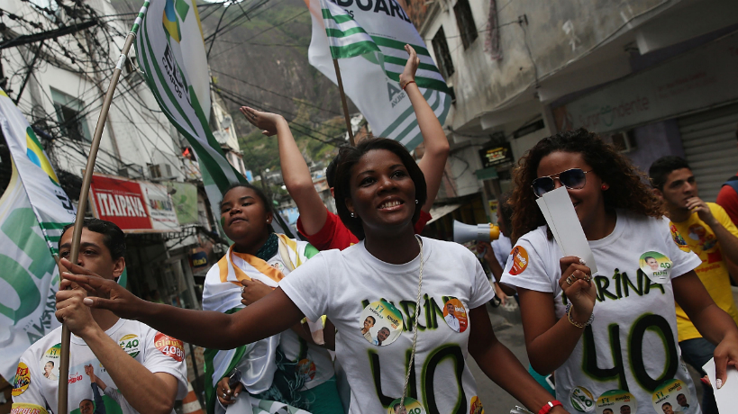
Political system : *Democracy
The most multi-ethnic country in the world
Economic system : *Capitalism
*Democracy=Entrusting political sovereignty to the people
*Capitalism=People can make money freely as an individual
Notes:
The political system in Brazil is a democracy.
Also, Brazil is the most multi- ethnic country in the world.
But there is no conflict of religion, ethnicity, and race.
The economic system in Brazil is Capitalism, so people can make money freely as an individual.

Slide 20
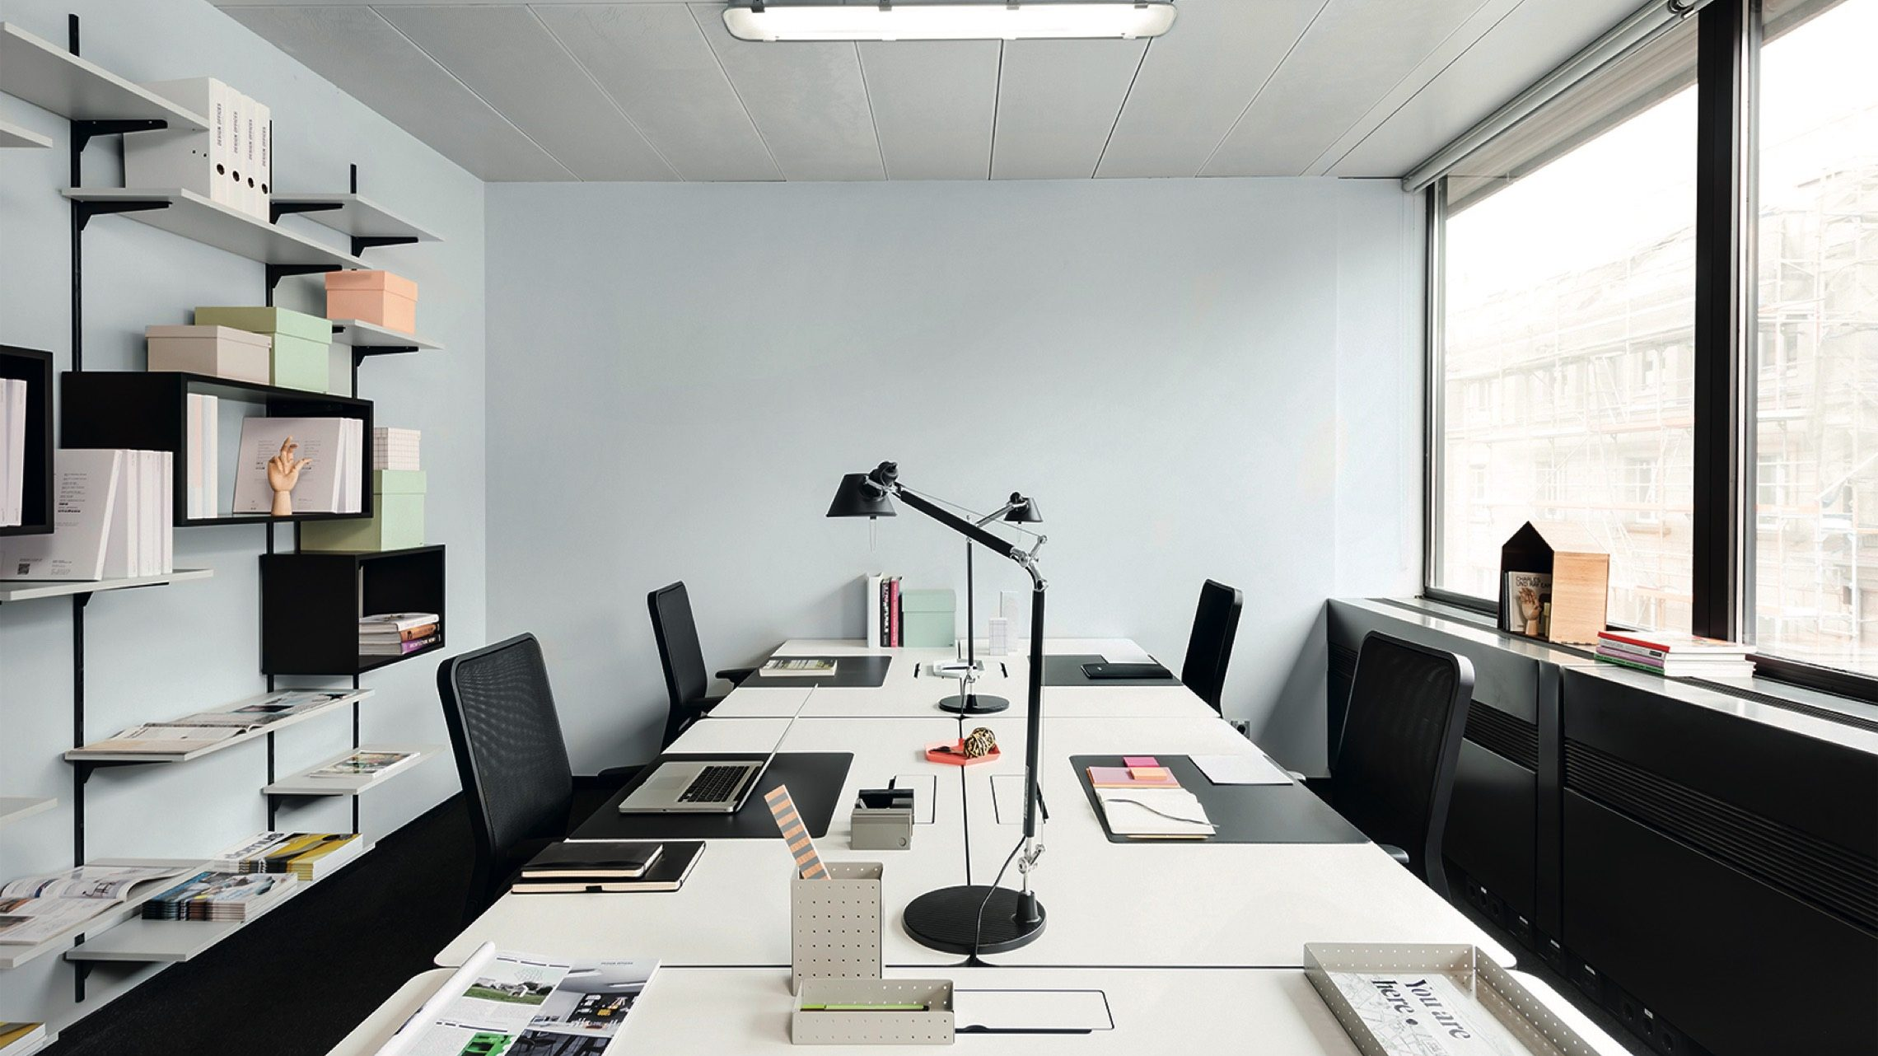
Work environment
Vacation Time
  30 days off each year
44 hours a week
Overtime is limited to 2 hours
  50% extra salary

Slide 21
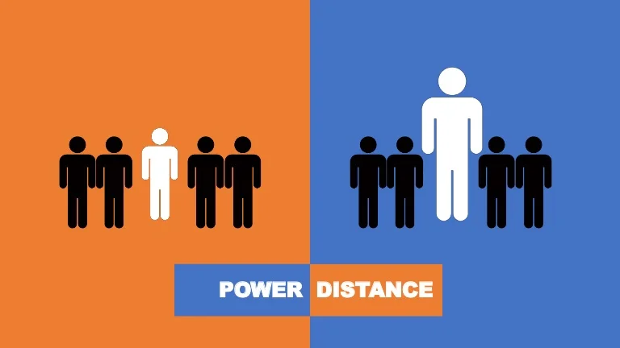
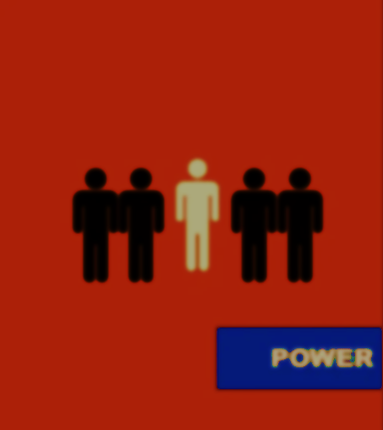
High Power Distance
hierarchical relationships
inequalities

Slide 22
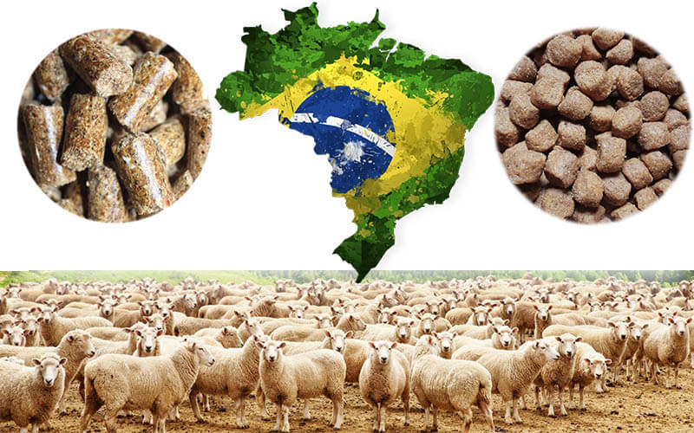
Industry
Notes:
Next, I talk about Brazilian industry.

Slide 23
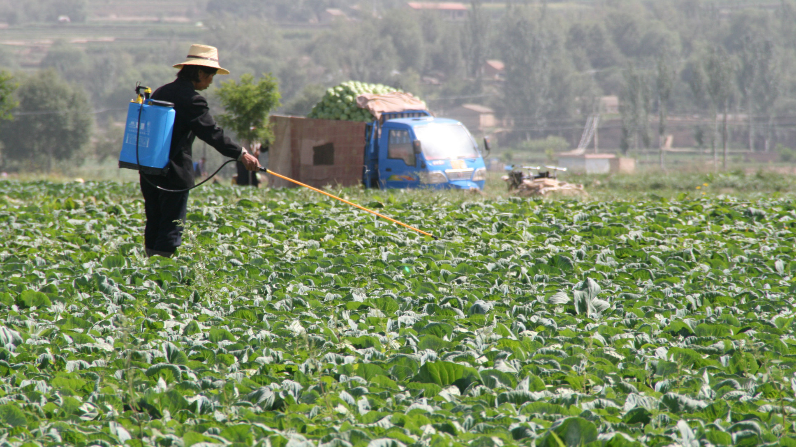
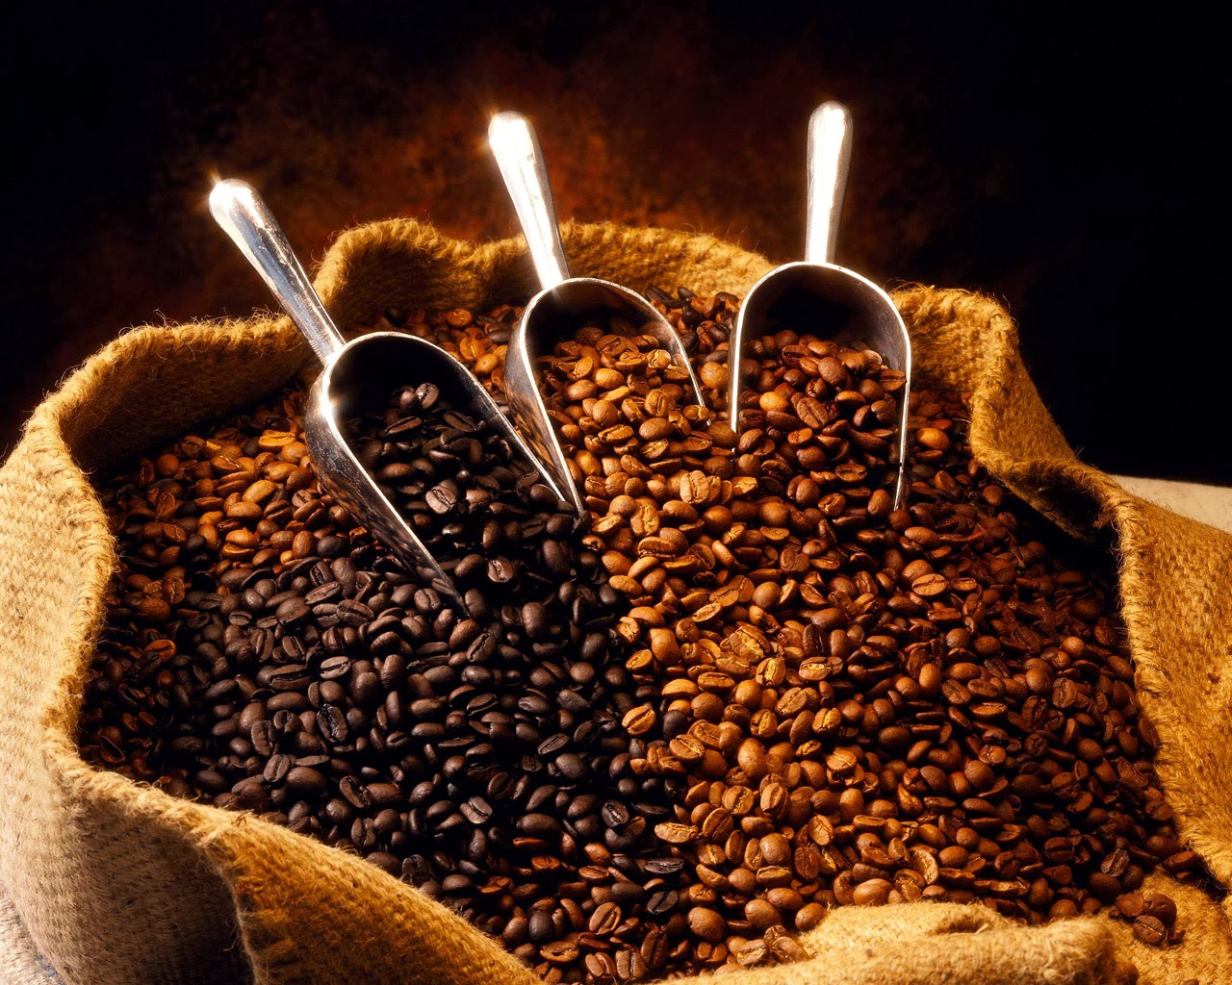
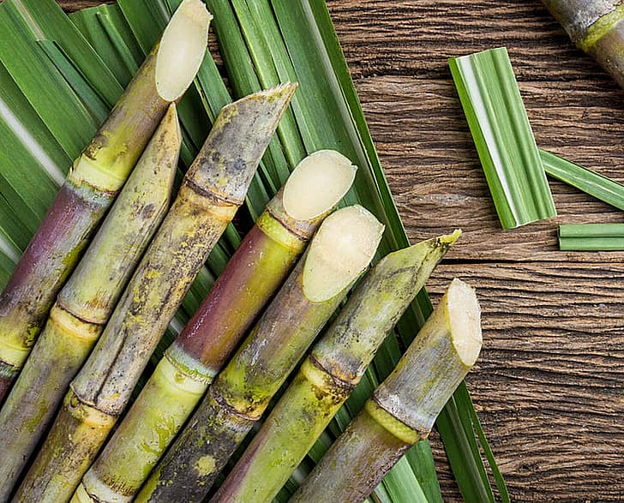
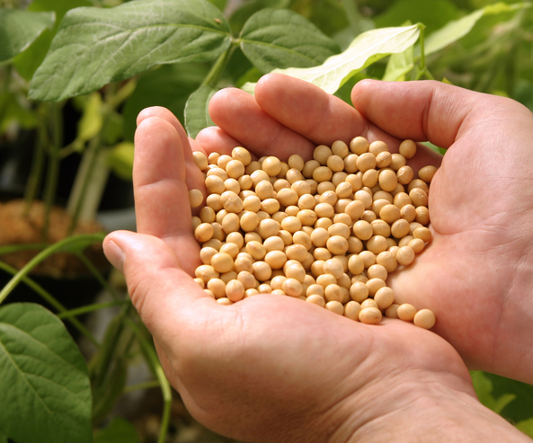
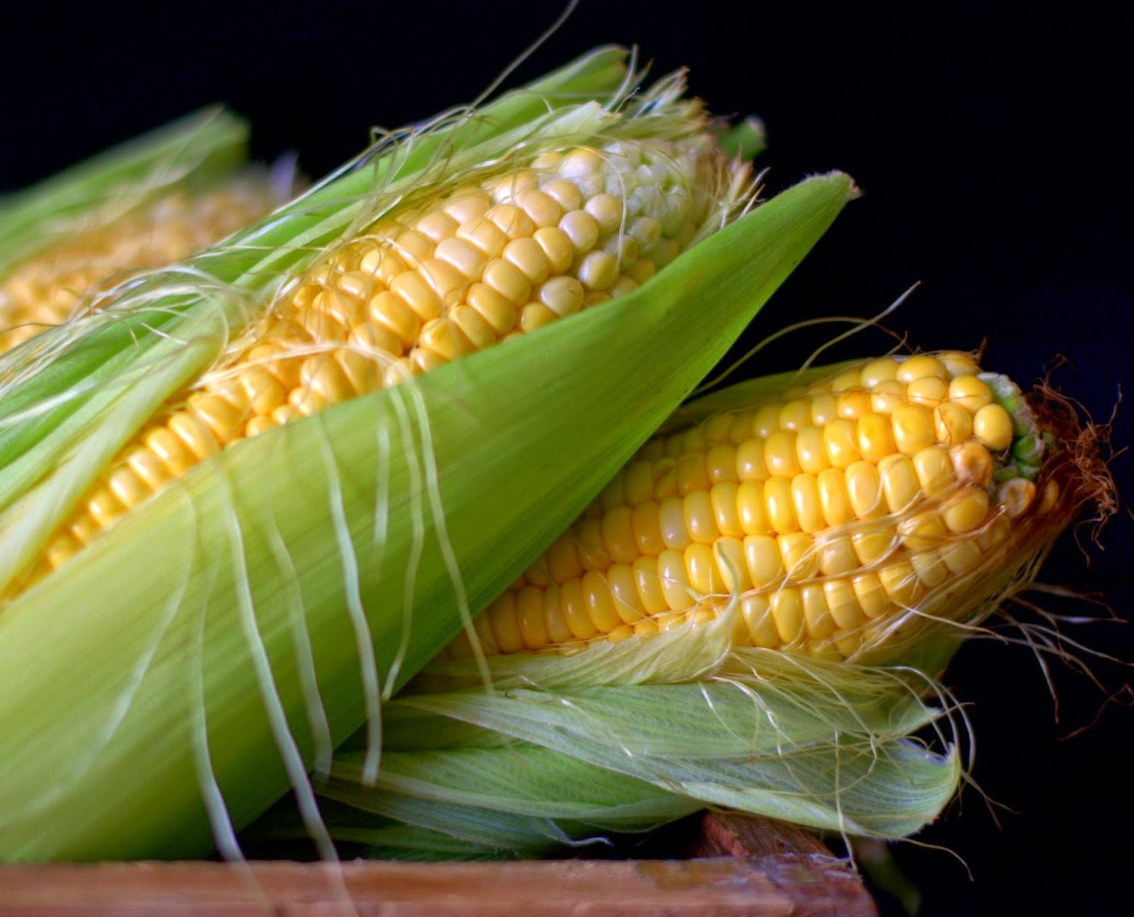
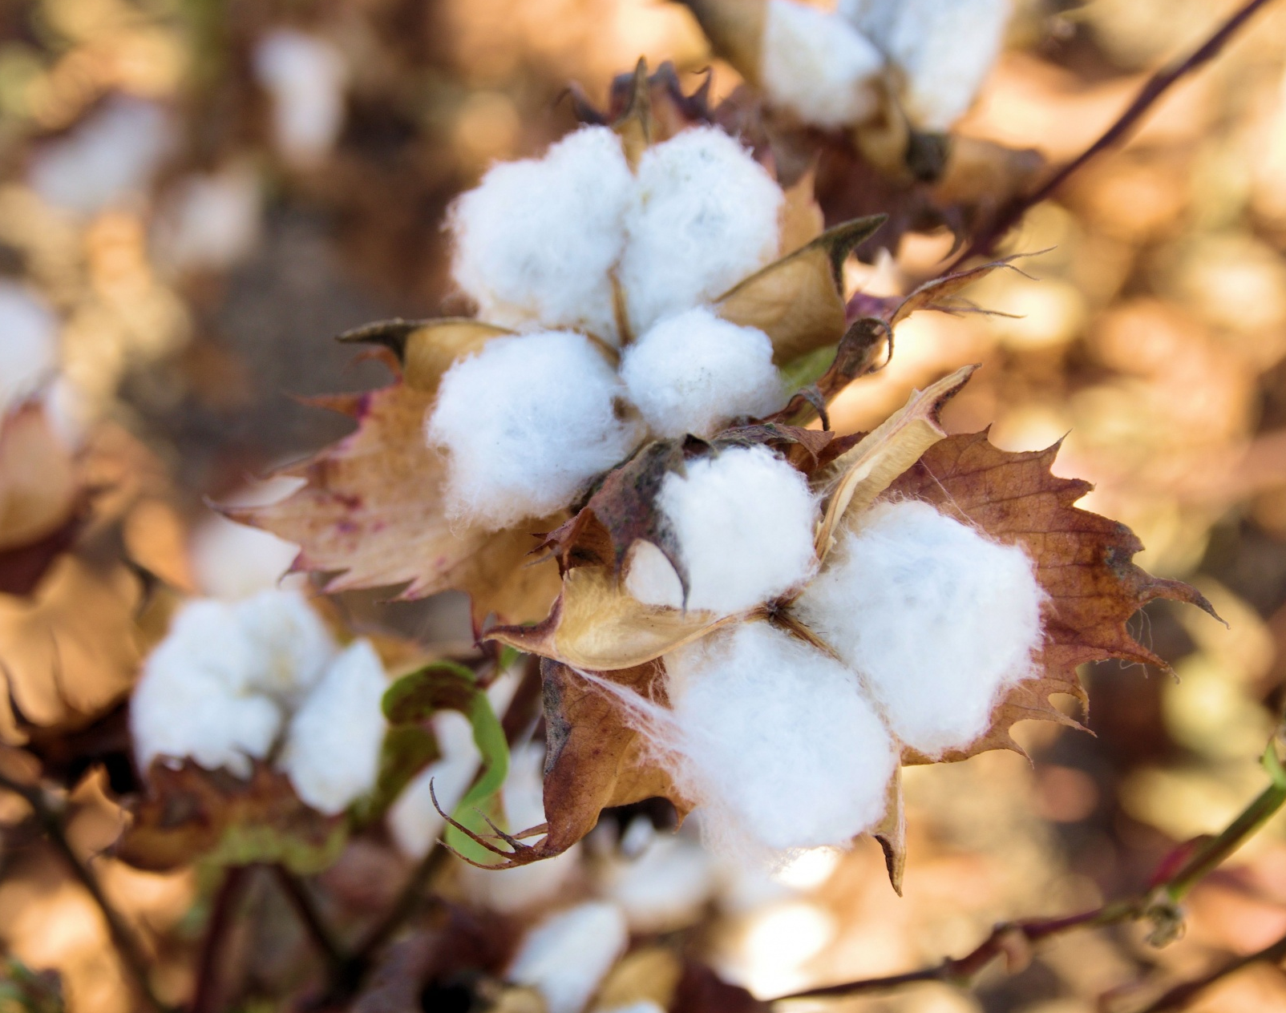
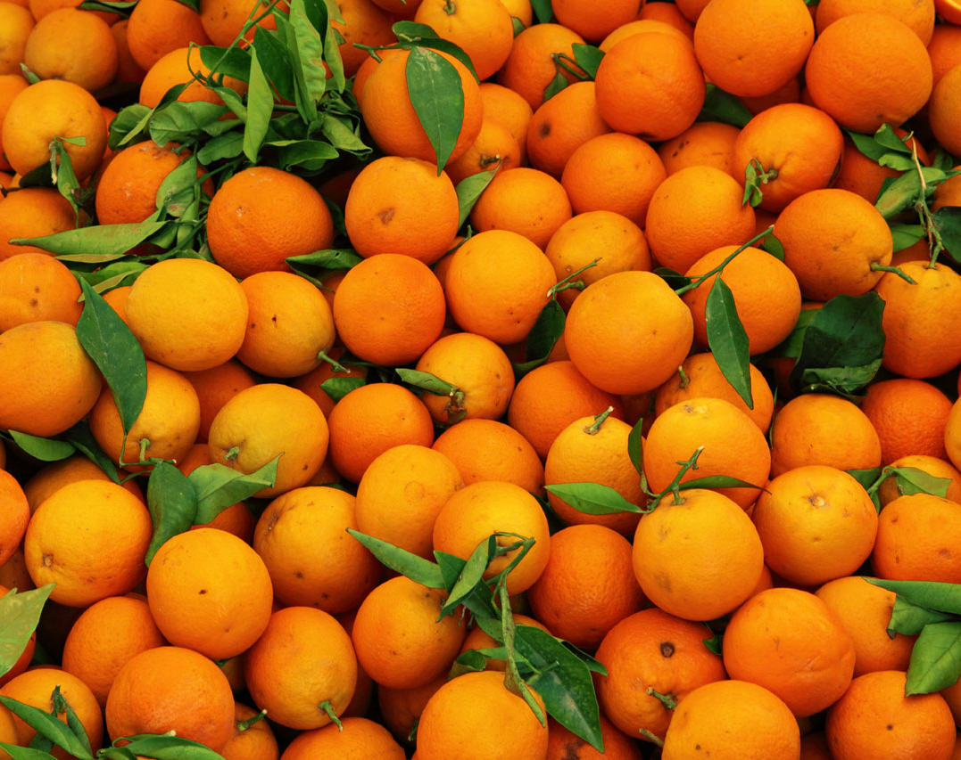
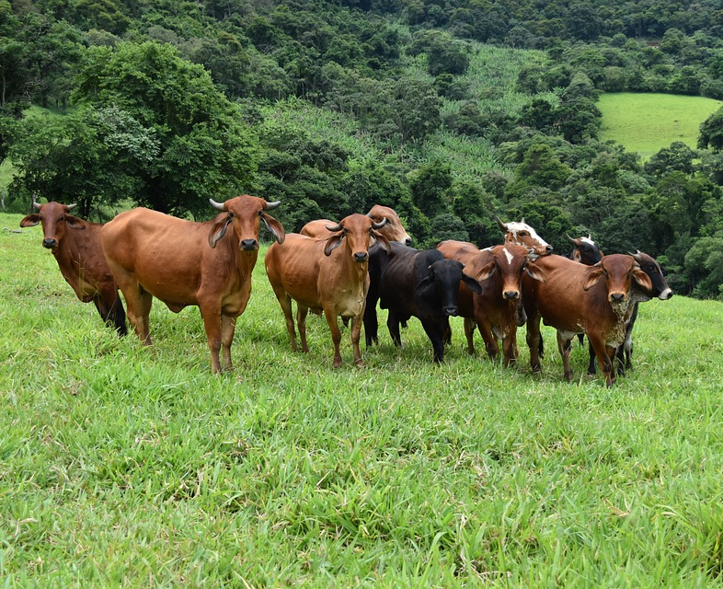
Agricultural country
Coffee
Sugar cane
Soybean
Corn
Cotton
Orange
Beef
Notes:
Brazil is an agricultural country.
So Brazil produces many crop plans.
For example, there are coffee, sugar cane, soybean, corn, cotton, orange, and beef.
Especially, many people have an image of Brazil coffee.

Slide 24

Coffee bean
No. 1 coffee producer
No. 1 export volume
2nd place in consumption

Slide 25
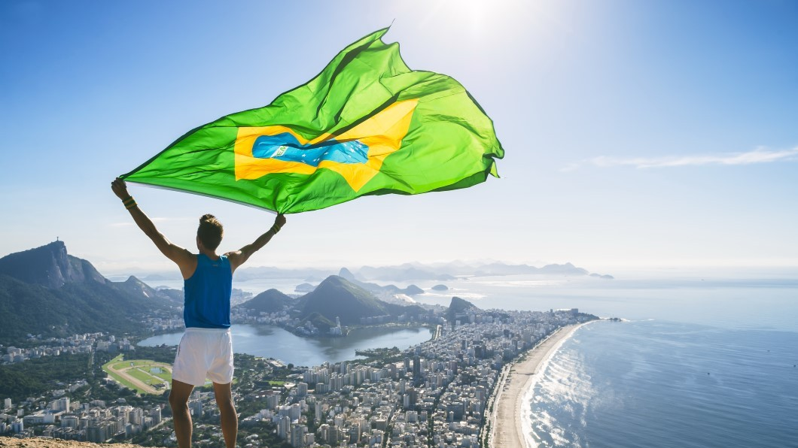
Thank you for listening
Notes:
Thank you for listening☺

Slide 26
Let’s play Kahoot

