Slide 1
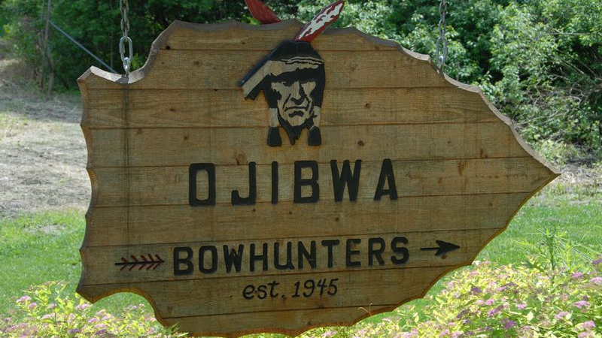
Nanase Hashimoto
Yuki Mukaiyama

Slide 2

Outline
About Ojibwa
History
Lifestyle

Slide 3
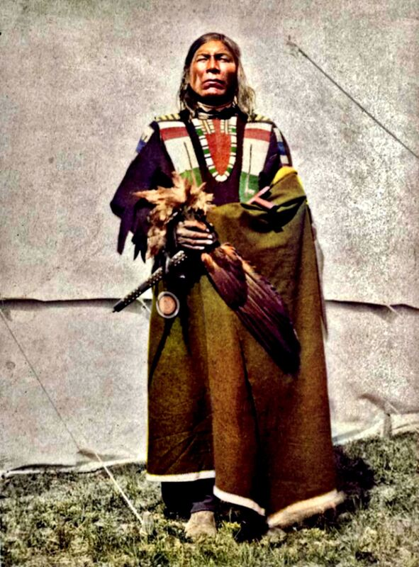
Ojibwa

Slide 4
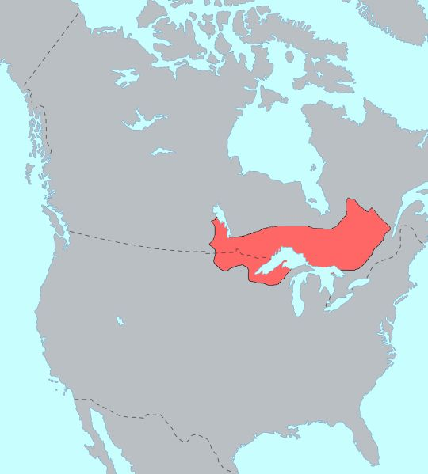
Region : Canada(Quebec, Ontario,
Manitoba, Saskatchewan,
Alberta)
The U.S ( Michigan,
Minnesota )
Language : English, French,
Ojibwe(Anishinaabemowin)
Culture : fishing and hunting for food

Slide 5
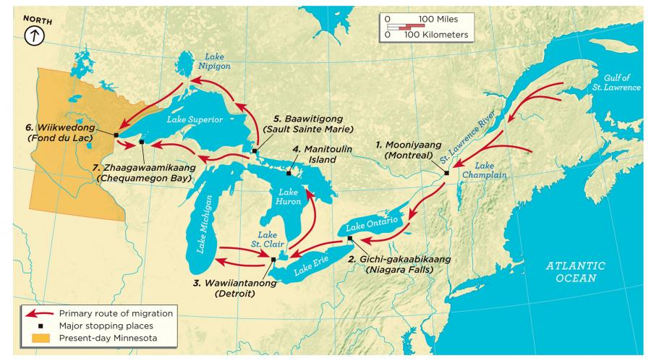

Slide 6
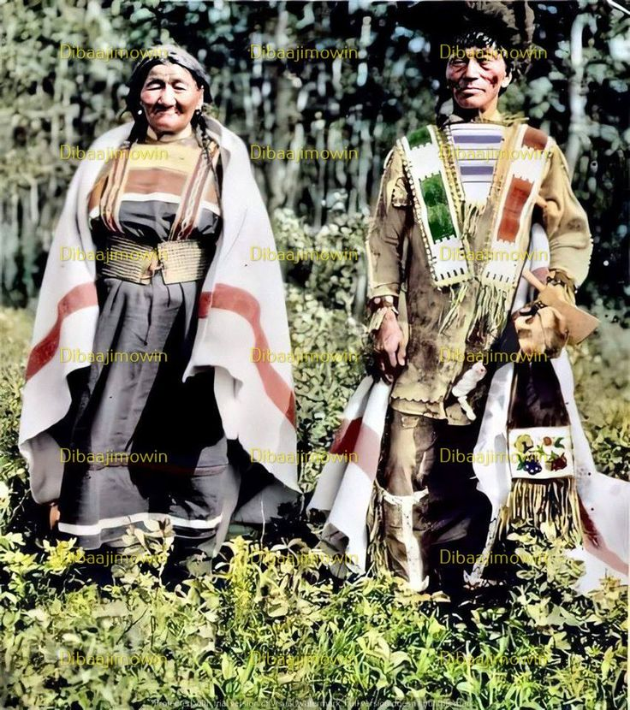

Relationship between Ojibwe and Hudson’s Bay

Slide 7
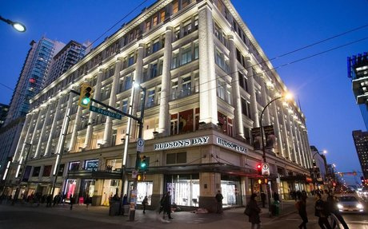
Hudson’s Bay Company
The oldest joint- stock company in the English-speaking world.
HBC was a fur trading business for the most of the Bay’s history.
The trading to meet European demand for beaver fur.

Slide 8
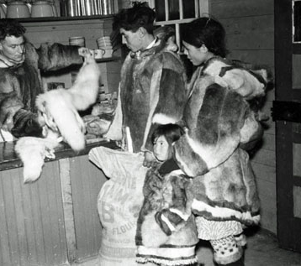
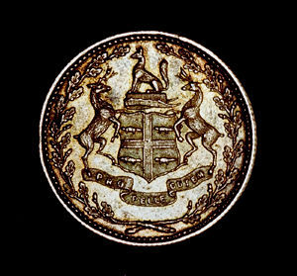
Trading fur
Beaver coin

Slide 9
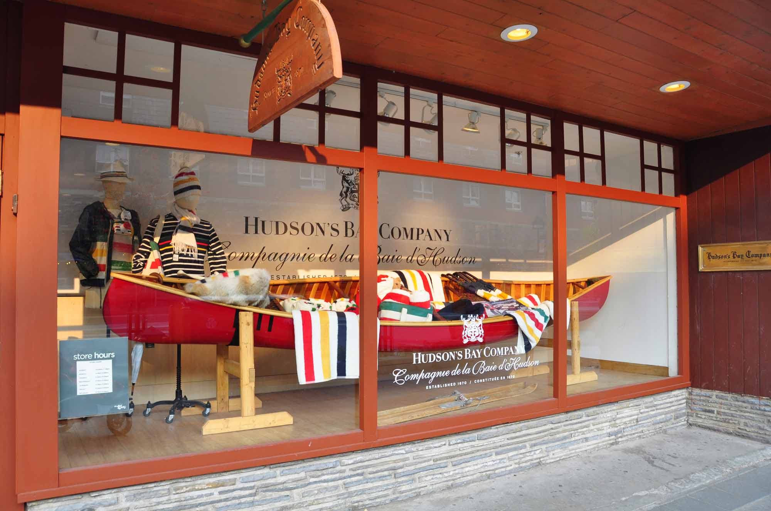
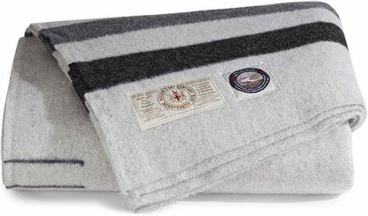
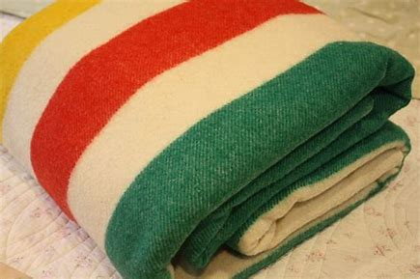

Slide 10
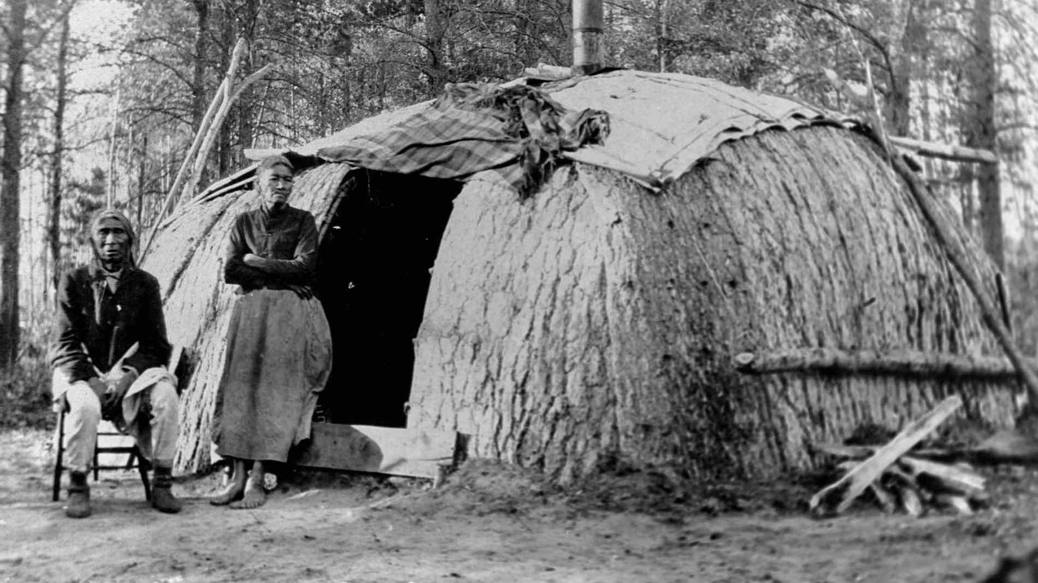
Lifestyle
Notes:
Next, I’ll introduce lifestyle of Ojibwe.

Slide 11
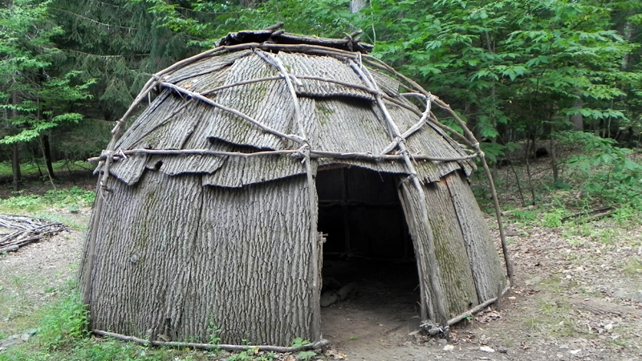
Wigwam
In winter
Semi-permanent domed or corn-shaped house.
Made from wood
Shelter in a new place
Notes:
This is a house called Wigwam. This is a semi-permanent domed or corn-shaped house. They(Ojibwe) spent much time inside this house in Winter. Wigwam were typically made from wood, but sometimes, animal skins were used to cover the outer walls of the structures. It was built to be easily disassembled and assembled so that families who were hunting and traveling can have a shelter in a new place. Because of this, they were able to live more safety.

Slide 12
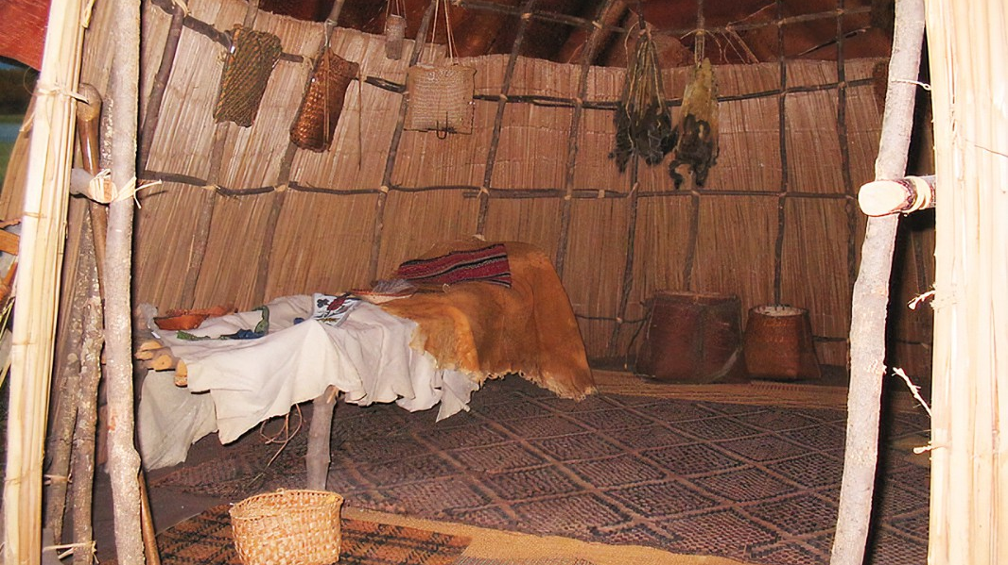
Inside wigwam
Families gathered
Accommodate up 10 to 12 people
Used for shelter
Houses of worship or for community meeting place
Notes:
Wigwams were places where families gathered to talk, eat and sleep. Although the size differed depending on the family ad community, these buildings have enough space to accommodate up to 10 to 12 people. Typically, Wigwams were used for shelter, but also, it could be used as houses of worship or for community meeting place. In these case, wigwams were lager and could accommodate about 25 people.

Slide 13
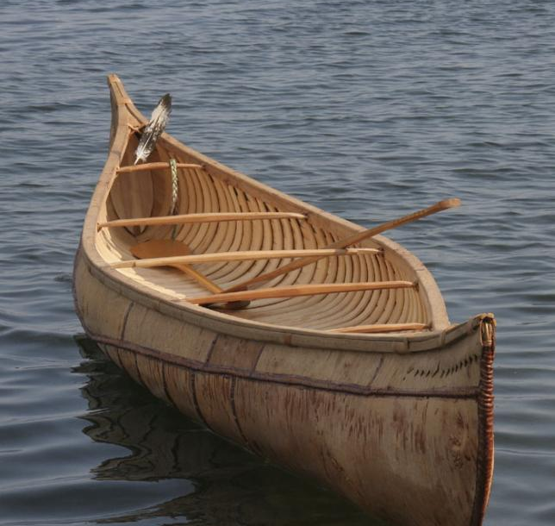
Birchbark
Water transportation
Summer trip
Ideal material
Notes:
They travelled and hunted by using Birchbark in warm weather. The birchbarks were main way of water transportation for them, so this was used mainly for trade. These were light and easy to operate, so these were perfectly adapted to summer trip through rapids river, ponds, and lakes of Canada. Birchbark was an ideal material for canoe construction, being smooth, hard, light, and waterproof.

Slide 14
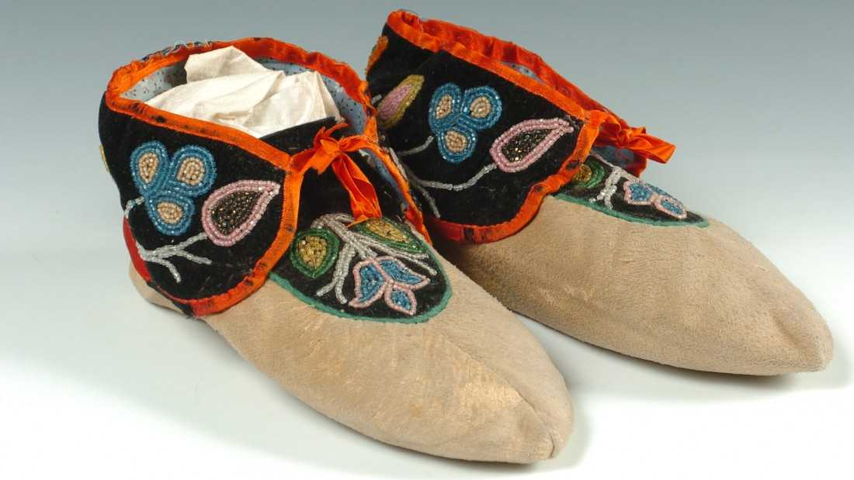
Moccasin
Notes:
Moccasins are a type of footwear and this is often made from animal hide. This was traditionally made and worn by various aboriginal people in Canada. This was comfortable walking shoes to keep their feet warm and dry. They are wide at the bottom, and tighter at the top. In areas with harsh winter, aboriginal people designed moccasins with soft shoes so as to fit easily into snowshoe. Today, moccasins are still used as ether outdoor shoes or indoor slippers by aboriginal people and non-aboriginal people.

Slide 15
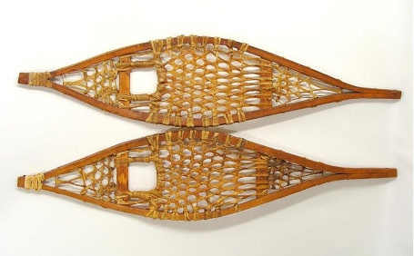
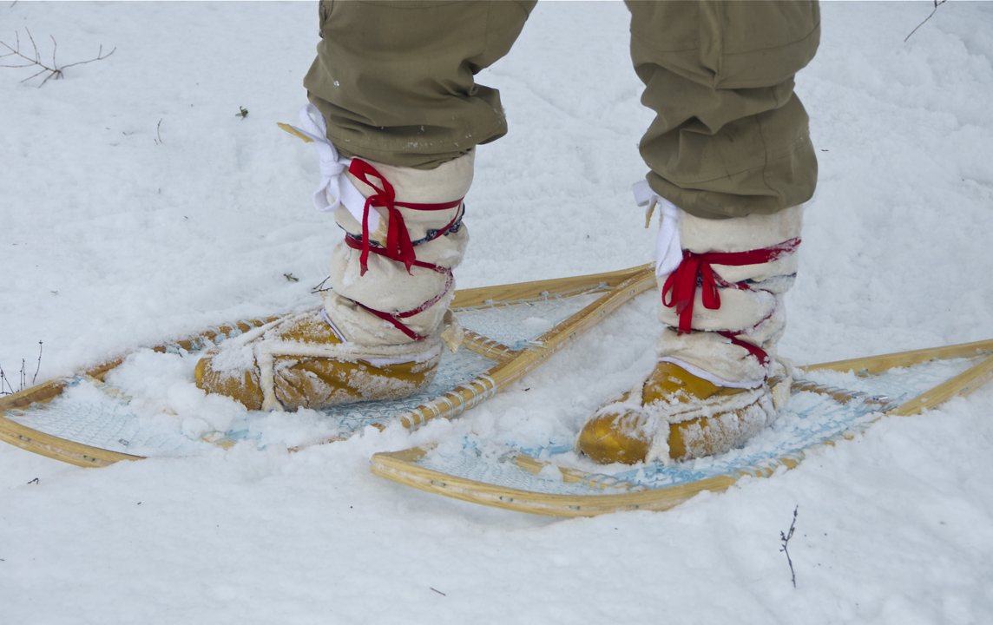
Snowshoe
Help to distribute the weight of person
Prevent them from sinking into the snow
Hunt without making noise
Notes:
They used snowshoe to walk on a snowy road. Snowshoe are also footwear that help to distribute the weight of a person while they walk over deep snow. This was used in combination with moccasins. By using this, it could prevent them from sinking into the snow. Also, it was useful for hunting because they were able to hunt without making noise by using this.

Slide 16
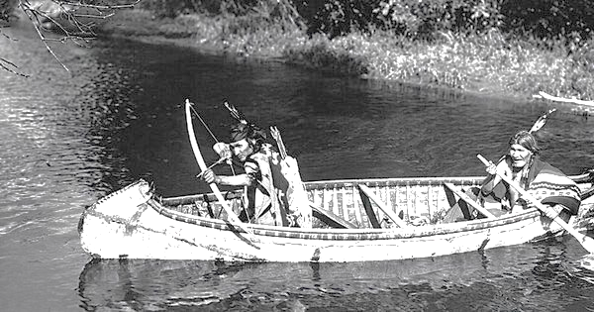
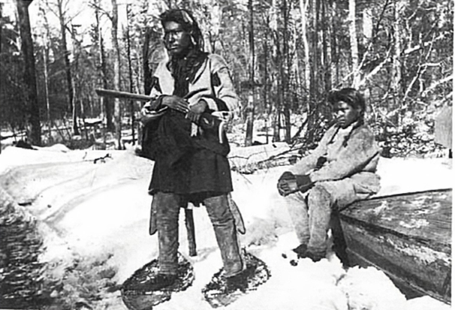
The role of a man
Notes:
Next, I’ll explain about the role of a man. Using the tools I just introduced, the men went hunting. As you can see, they used birchbark for hunting. In winter, they used snowshoe. This was useful tool for hunting. The man were responsible for hunting.

Slide 17
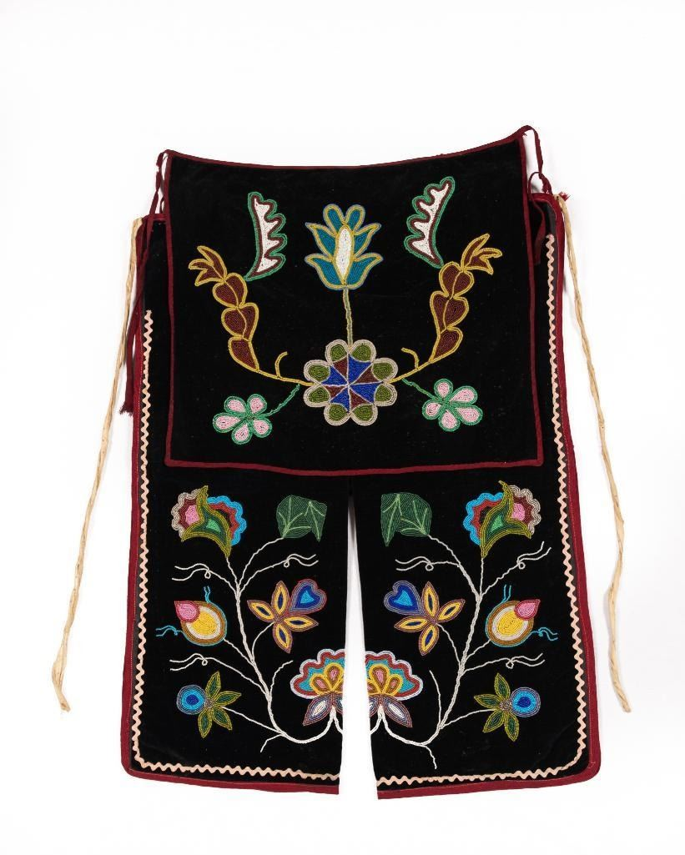
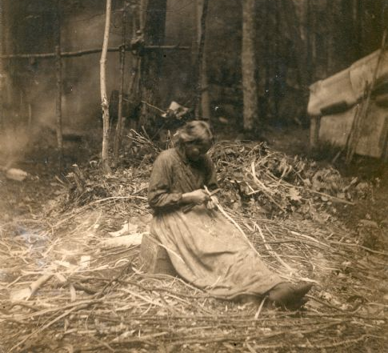
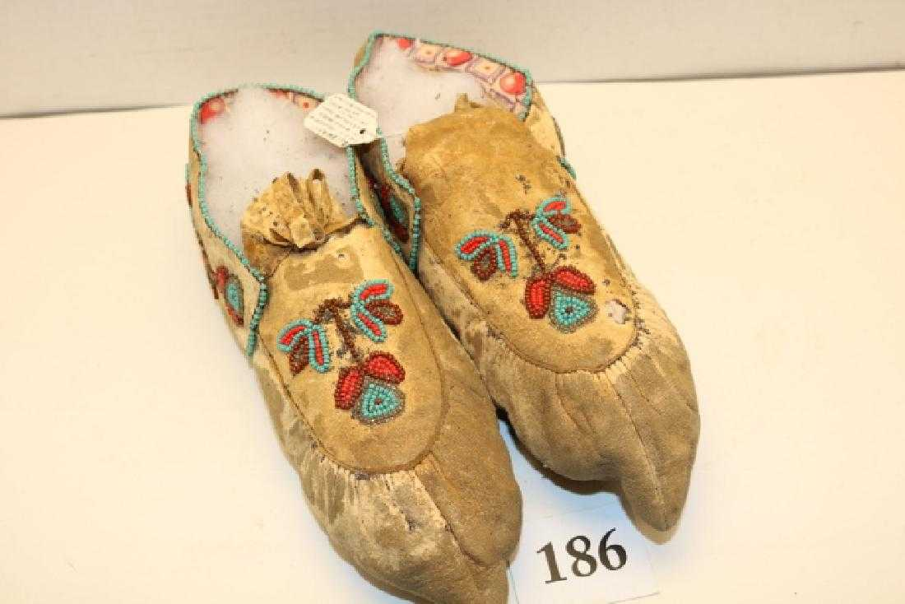
The role of a woman
Notes:
On the other hand, while man were hunting, woman were making moccasins, leggings, clothes and dress. These were woman’s job.

Slide 18

Conclusion
A part of lager cultural group
Essential parts of the fur trade economy
Hunting and fishing by using materials
Suitable for each climate
Notes:
In conclusion, we learned that the Ojibwe are an aboriginal people in Canada and the United States who are part of a larger cultural group. They became essential parts of the early fur trade economy. They lived around hunting and fishing, using materials suitable for each climate.

Slide 19


